Slide 1
Chapter Meeting - September 9, 2023

Slide 2
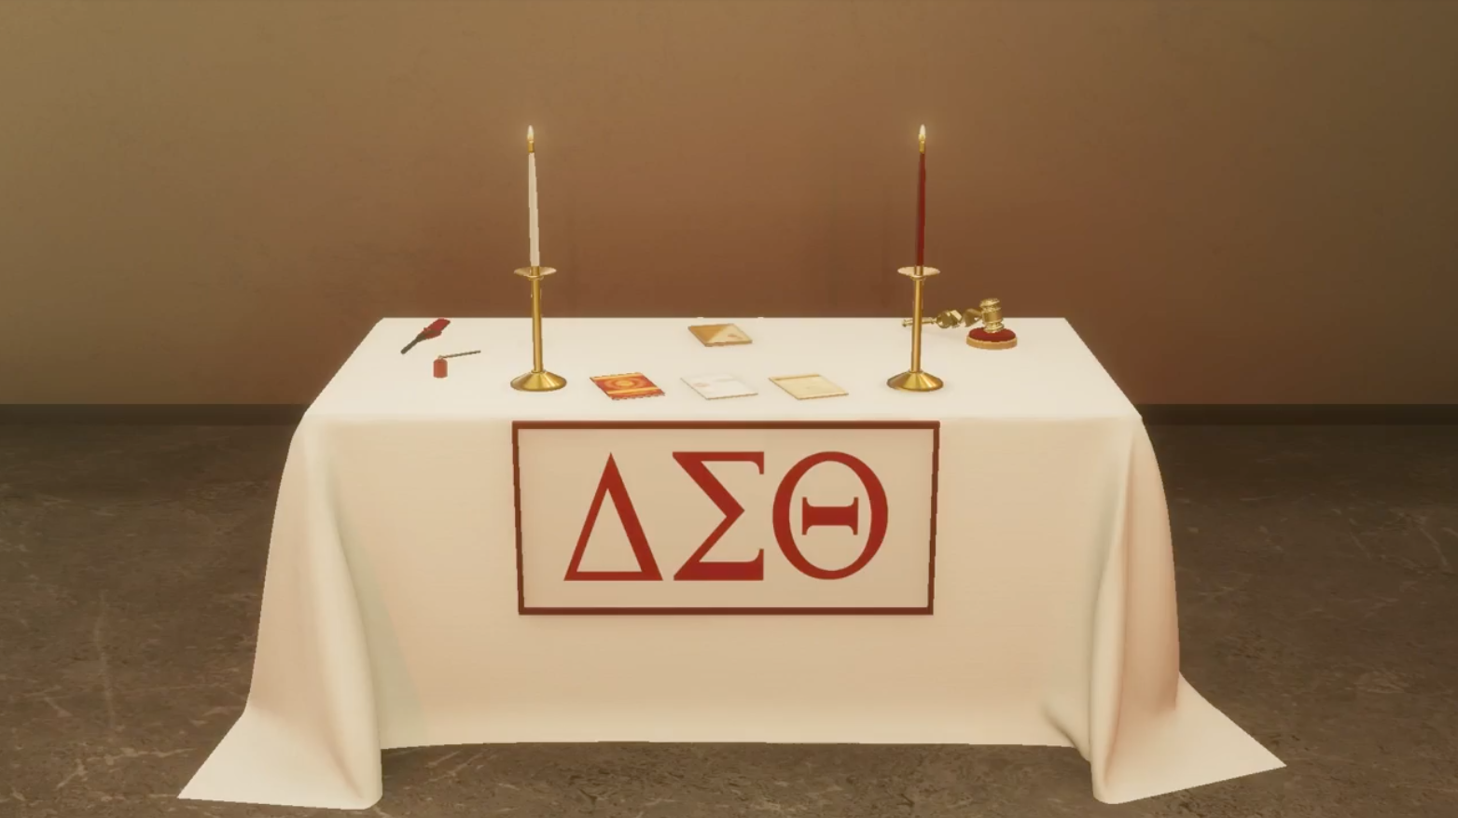

Slide 3
Delta Sigma Theta Sorority, Incorporated
Legal Notice
ALL CONTENT SHARED, DISPLAYED, OR OTHERWISE PRESENTED DURING THIS MEETING, INCLUDING BUT NOT LIMITED TO SORORITY MANUALS, CEREMONIAL RITUALS, AND OTHER MATERIALS THAT CONTAIN DELTA’S TRADEMARKS, COPYRIGHTS, OR ANY OTHER INTELLECTUAL PROPERTY, IS OWNED AND CONTROLLED BY DELTA SIGMA THETA SORORITY, INC. AND IS PROTECTED BY LAW. PARTICIPANT SHALL NOT PHOTOGRAPH, VIDEO RECORD, SCREEN CAPTURE, OR OTHERWISE COPY DELTA MATERIALS TO MODIFY OR REPRODUCE FOR PERSONAL OR THIRD-PARTY USE. PARTICIPANT FURTHER UNDERSTANDS, AGREES, AND ACKNOWLEDGES TO BE SOLELY LIABLE FOR ANY DAMAGES, IN LAW OR IN EQUITY, RESULTING FROM VIOLATION OF APPLICABLE LAWS AND SHALL BE SUBJECT TO DISCIPLINARY ACTION ACCORDING TO THE MEMBER CODE OF CONDUCT AND ANY OTHER RELATED AGREEMENT.

Slide 4
Emergency Response Committee Chair
Emergency Response Safety Briefing
Adoption of Agenda
Introductions/Greetings
Minutes
Communications
Chapter Reports
Protocol Moment
Committee Reports
Social Action Moment
Standing Committees
Unfinished Business
New Business
Announcements
Adjournment

Slide 5
Meeting Agenda
Call to Order
Adoption of Agenda
Introductions/Greetings
Minutes
Communications
Chapter Reports
Protocol Moment
Committee Reports
Social Action Moment
Standing Committee
Unfinished Business
New Business
Announcements
Adjournment

Slide 6
Meeting Agenda
Adoption of Agenda
Introductions/Greetings
Minutes
Communications
Chapter Reports
Protocol Moment
Committee Reports
Social Action Moment
Standing Committees
Unfinished Business
New Business
Announcements
Adjournment

Slide 7
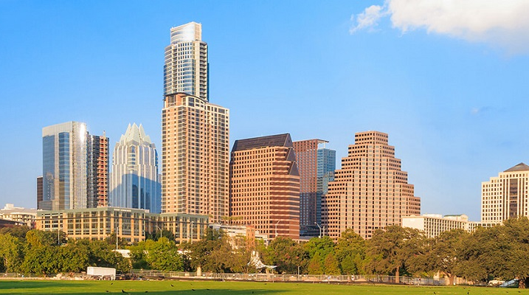
Welcome Visiting Sorors!
Introductions/Greetings
Minutes
Communications
Chapter Reports
Protocol Moment
Committee Reports
Social Action Moment
Standing Committees
Unfinished Business
New Business
Announcements
Adjournment
Welcome to Austin!

Slide 8
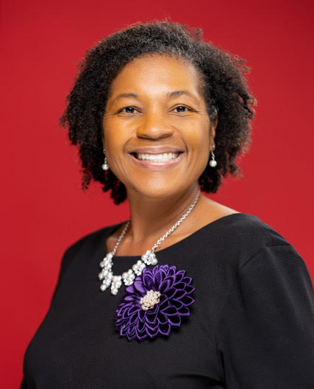
Recording Secretary
Adoption of Agenda
Introductions/Greetings
Approval of May Minutes
Communications
Chapter Reports
Protocol Moment
Committee Reports
Social Action Moment
Standing Committees
Unfinished Business
New Business
Announcements
Adjournment
Soror Darralyn Johnson

Slide 9
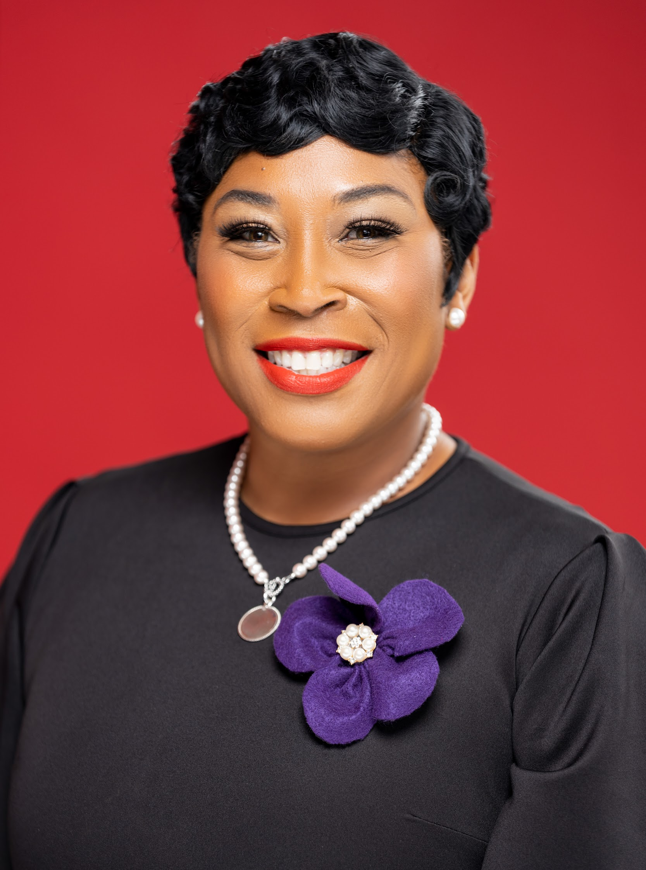
Corresponding Secretary
Adoption of Agenda
Introductions/Greetings
Minutes
Communications
Chapter Reports
Protocol Moment
Committee Reports
Social Action Moment
Standing Committees
Unfinished Business
New Business
Announcements
Adjournment
Soror La’Kisha Crenshaw

Slide 10
Meeting Agenda
Chapter Reports
President
2nd Vice President
Financial Secretary
Treasurer/Budget & Finance
Protocol Moment
Committee Reports
Social Action Moment
Standing Committees
Unfinished Business
New Business
Announcements
Adjournment

Slide 11
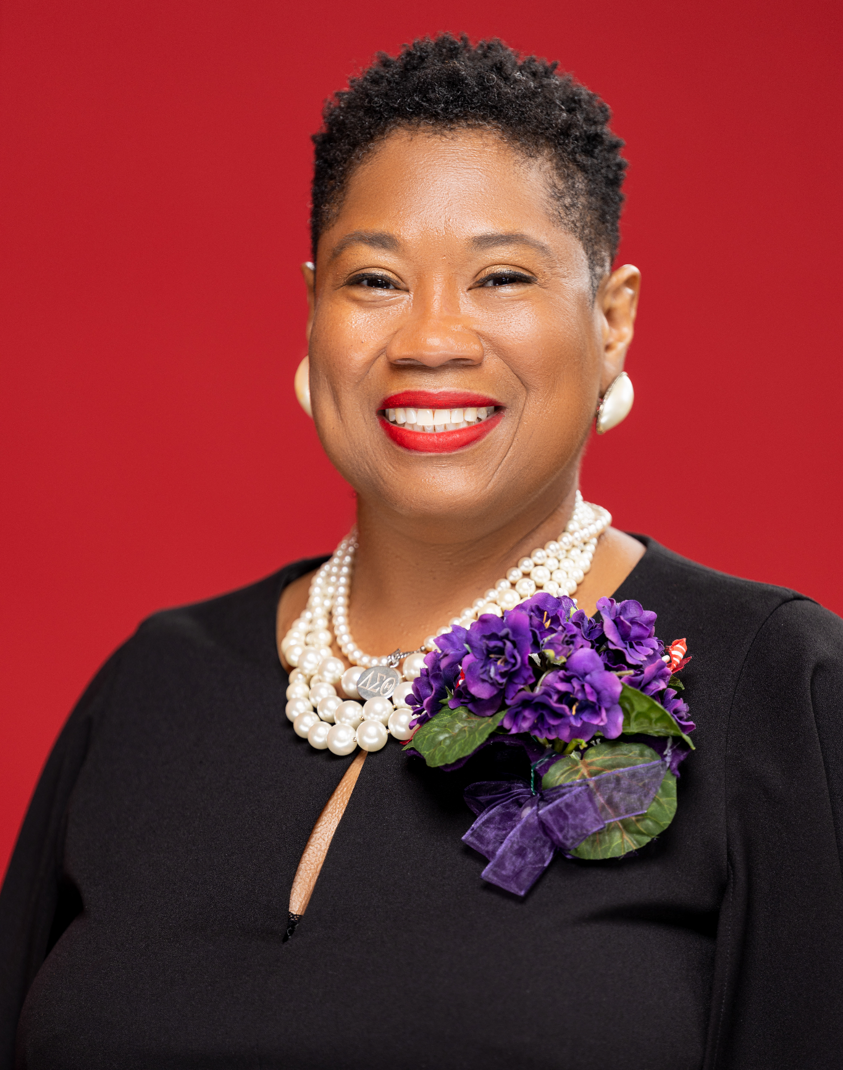
President’s Report
2023-24 Sorority Year Welcome
2023 Chapter Theme
“Moving Forward: One Delta, One Bond, One Love. We are One!”
Soror Robin Blackmon

Slide 12
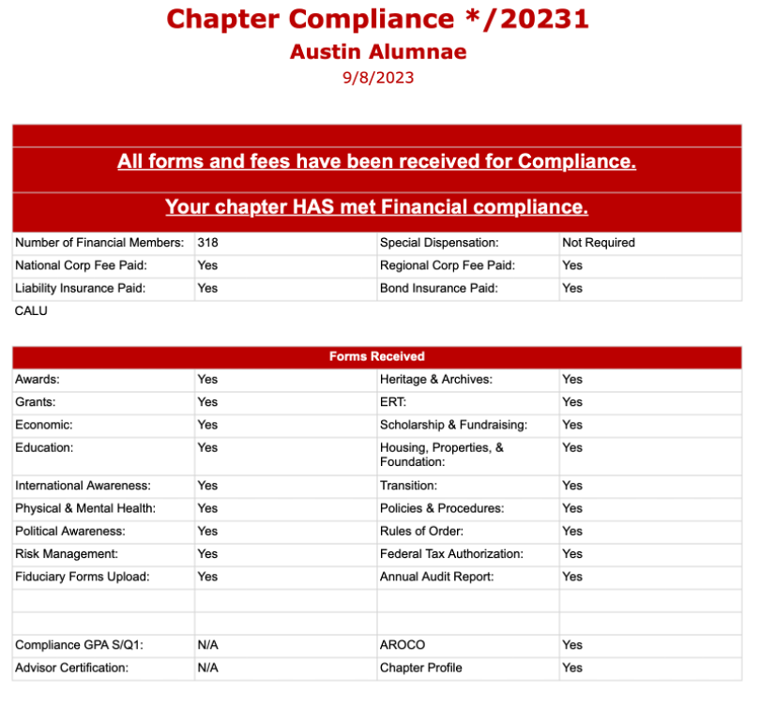
Soror Robin Blackmon

Slide 13
President’s Report
Membership Services
2023 Retreat
Mission Accomplished
Fun
Fellowship
Sisterly Bonding
Soror Robin Blackmon

Slide 14
Sister II Sister Circle Initiative
Objective:
Organizing the chapter to more effectively build sisterly bonds and support, serve in the member’s immediate community, and accountability in emergency situations
Focus:
Socializing
Supporting
Securing
Serving
Soror Robin Blackmon

Slide 15
President’s Report
Regional Update
State of the Region Address:
Regional Director Barker held her State of the Region Address on Sunday, August 13. She provided data on the outstanding work in the SWR and the leaders that have and currently represent the SWR in National roles. She encouraged and motivated us to be in the room at the school board meetings and in our communities.
Soror Robin Blackmon

Slide 16
56th National Convention Report
Election Results
International President and CEO, Board of Directors – Elsie Cooke-Holmes (SW)
National First Vice President – Cheryl Turner (SO)
National Second Vice President – Sade’ Ried (FW)
National Secretary – Joi Moore (CE)
National Treasurer – Rosalyn Glenn (SA)
Chair, 2025 National Nominating Committee – Janelle Baker (SO)
Alumnae Member, National Audit and Corporate Compliance Committee – Deloris Drakes (EA)
Collegiate Member, National Scholarship and Standards Committee - Tamia Brown (SA)
Collegiate Member, National Finance Committee – Allison Keith (EA)
Collegiate Member, 2025 National Nominating Committee – Ryane Jones (EA)
Collegiate Member, National Audit and Corporate Compliance Committee – Denielle Clarke (EA) and Jordan Sampson (SO)

Slide 17
Ambassador Bonnie D. Jenkins
Channing Dungey
Rashida Jones
Tamika Catchings
Debra Lee
Phyllis Newhouse
Justice Ketanji Brown Jackson

Slide 18
56th National Convention
Constitution and Bylaws
There were 35 proposed amendments. While there were amendments to some of the amendments, 34 of the amendments were adopted, 1 failed. Some highlights:
1. The National President will be called the International President and Chair of the National Board of Directors.
2. Minimum quorum requirement is 25%.
3. Discussion on sorors who renounces Delta and fails to inform and comply with the renouncement process shall be expelled for violation of the Code of Conduct intellectual property.
4. Initiation Fees increased for grand chapter and local chapter maximum increased.
5. Filling vacancies in the immediate Past President position (new).

Slide 19
56th National Convention
Officers and Committee Reports
International President
1st Vice President
2nd Vice President
Treasurer
Finance Committee
Audit and Compliance
Soror Robin Blackmon

Slide 20
56th National Convention
Credentials
60 | National Board of Directors
8 | Past National Presidents
825 | Voting Delegates
736 | Alternate Delegates
12,896 | Non-voting delegates
9,983 | Virtual Non-voting delegates
320 | Hostess Chapter on site
176 | Exhibitors (companies)
13 | Honorary Members
28 | Staff: Non-Deltas
722 | Family / Guests
542 | Alumnae Chapters
283 | Collegiate Chapters
11 | Chapters Not Present
24,841 | Total Deltas
1,802 | Total Other
26,643 | Grand Total

Slide 21
2023 National Heritage and Archives Award Founders Day Presentation

Slide 22
Meeting Agenda
Chapter Reports
President
2nd Vice President
Financial Secretary
Treasurer/Budget & Finance
Protocol Moment
Committee Reports
Social Action Moment
Standing Committees
Unfinished Business
New Business
Announcements
Adjournment

Slide 23
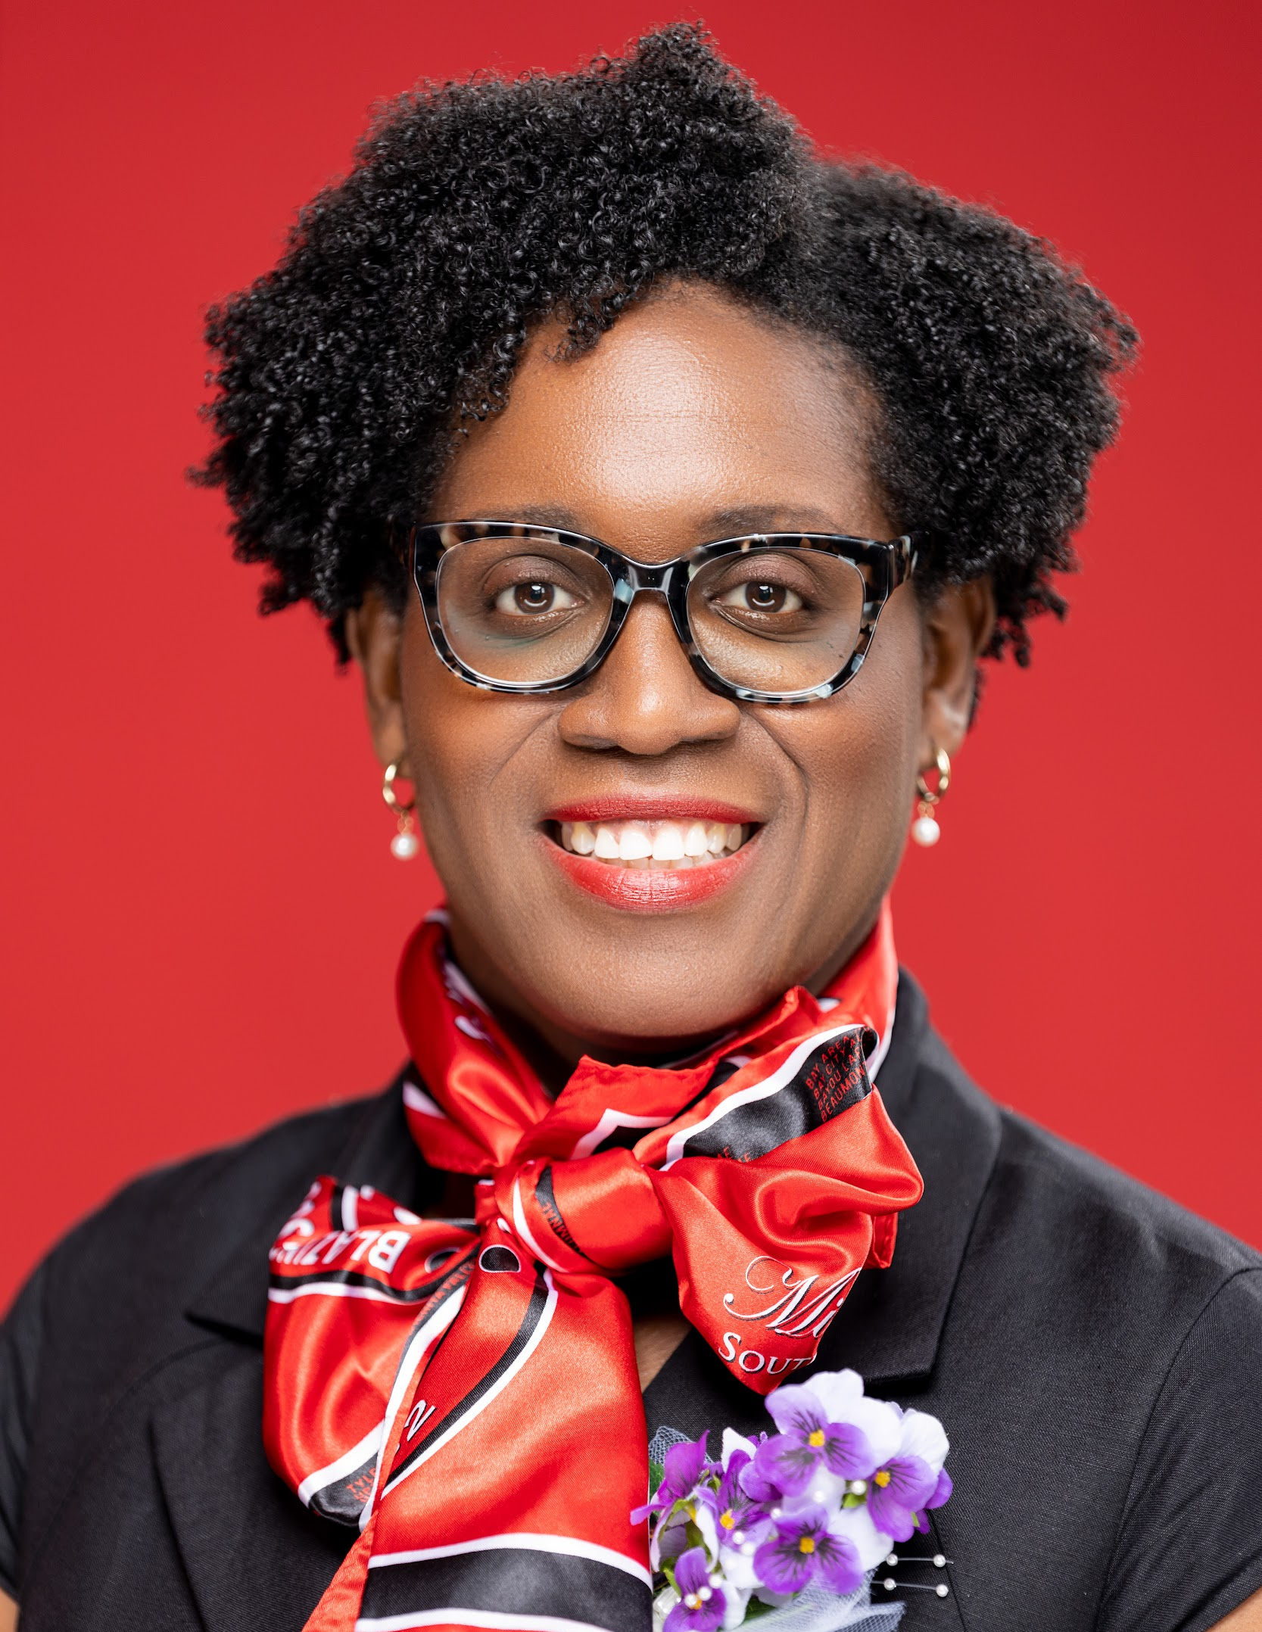
2nd Vice-President Report
Calendar Update
Soror Kacey Hanson

Slide 24
Meeting Agenda
Chapter Reports
President
2nd Vice President
Financial Secretary
Treasurer/Budget & Finance
Protocol Moment
Committee Reports
Social Action Moment
Standing Committees
Unfinished Business
New Business
Announcements
Adjournment

Slide 25
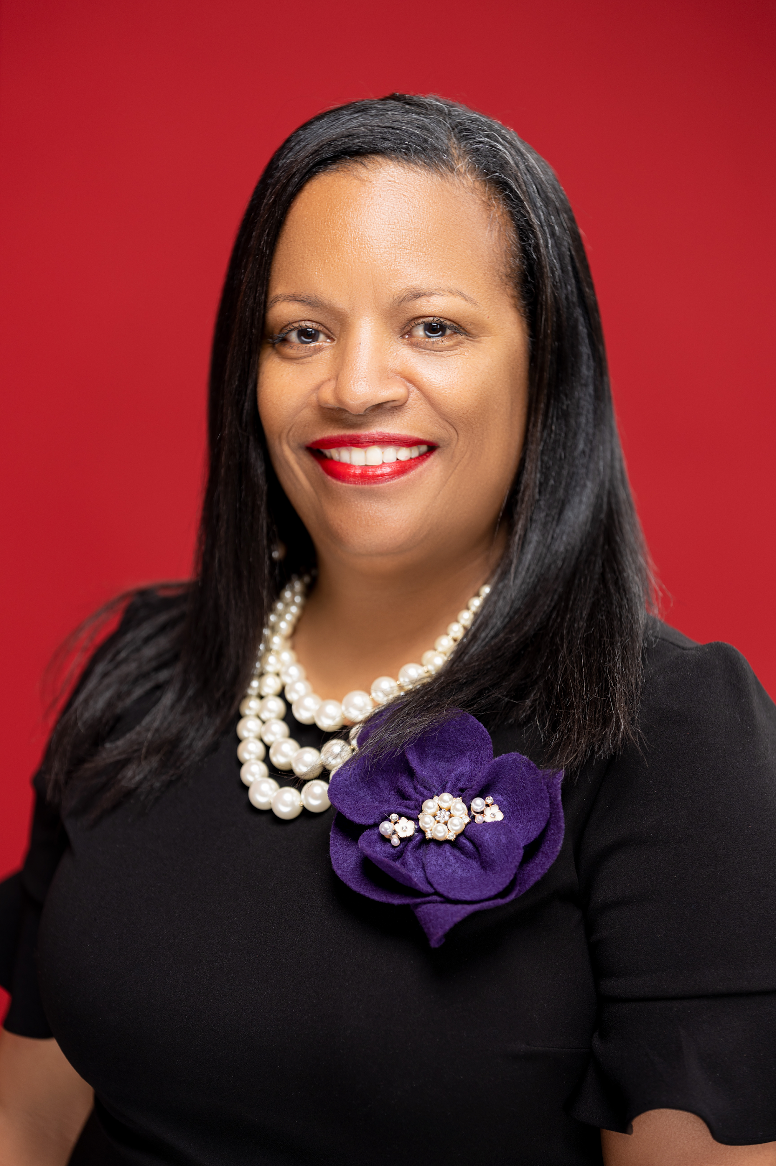
Financial Secretary
284 Members on the roster for SY 23
FY 24 DUES AMOUNT
Golden/Diamond Life | $195.00
Regular Member | $385.00
Soror Anita Daniels

Slide 26
Financial Secretary Total Collections for May-August 2023
23 Local Dues | $ 3445.00
24 Local Dues | $ 17,389.93
24 National Dues | $ 12,529.72
Regional Conference Donation/Seed Monies | $ 10,000.00
National Scarf | $ 1085.00
Popcorn Donation | $ 1122.00
Retreat | $ 3069.00
Tina Turner Off Broadway | $ 2310.00
22-23 Local Dues | $ 185.00
22-23 National Dues | $ 200.00
TOTAL | $ 51,335.65
284 Members on the roster for SY 2023

Slide 27
Financial Secretary
2024 DUES AMOUNTS:
Golden/Diamond Life $195.00
Regular Member (Financial 22/23 & SY23) $385.00
Regular Member (Nonfinancial 1 year) $400.00
Regular Member (Nonfinancial 2 or more yrs) $415.00

Slide 28
Meeting Agenda
Chapter Reports
President
2nd Vice President
Financial Secretary
Treasurer/Budget & Finance
Protocol Moment
Committee Reports
Social Action Moment
Standing Committees
Unfinished Business
New Business
Announcements
Adjournment

Slide 29
Treasurer, Chair Budget & Finance Committee
Summary – Four Accounts
Ending Balances
Soror Deborah Shaw-Boatner

Slide 30
Accounts Summary
Account | Beginning Balance | Income | Disbursements | Ending Balance
Primary Savings | $16,135.98 | $12.21 | - | $16,148.19
Money Market | $17,362.41 | $33.63 | - | $17,396.04
Southwest Regional Conference * | - | $17,726.83 | - | $17,726.83
Primary Checking | $84,881.24 | $58,392.73 | ($43,693.96) | $99.580.01
Total | $ 118,379. 63 | $76,165.40 | ($43,693.96) | $ 150,851.07
Notes:
*$25.00 required balance

Slide 31
Budget & Finance
Modified the budget to reflect:
76 additional members ($7,030) – 76* $92.50
Additional income $ 12,598 from Fundraising Popcorn sales
With the additional income we were able to restore many of the budget requests from the committees. We will continue to monitor the budget to determine if any additional changes can be made during our next Budget and Finance Committee meeting on October 11, 2023.

Slide 32
Budget & Finance
Income adjustments - SY23
 |  |  | Budget | Budget
 |  | Budget | Adjustments | As Adjusted
Local Dues (76 * $92.50 ) |  | $18,500 | $7,030.00 | $25,530.00
Fundraising-Double Good Popcorn |  |  | $12,598.00 | $12,598.00
Total Operating Income |  | $18,500 | $19,628.00 | $38,128.00

Slide 33
Budget & Finance
Line item budget adjustments (expenses )
 | SY 23 Budget | Adjustments | Budget As Adjusted
Program Expenses
Arts & Letters | 300.00 | 1,375.00 | 1,675.00
Economic Development | 250.00 |  | 250.00
Educational Development | 1,500.00 | 8,448.00 | 9,948.00
EMBODI | 1,000.00 |  | 1,000.00
Academy | 250.00 |  | 250.00
GEMS | 250.00 |  | 250.00
GEMS (College trip) | - | 7,948.00 | 7,948.00
General Ed Dev | - | 500.00 | 500.00
International Awareness & Involvement | 225.00 | 75.00 | 300.00
Physical & Mental Health | 100.00 | 100.00 | 200.00
Social Action | 750.00 | 750.00 | 1,500.00
Ways & Means | 150.00 | 350.00 | 500.00
Emergency Response Team | 250.00 | 250.00 | 500.00

Slide 34
Budget & Finance
Line item budget adjustments (expenses ) – cont’d
 | SY 23 Budget | Adjustments | Budget As Adjusted
Program Expenses
Charitable Partners | - | 1,500.00 | 1,500.00
St. Jude Children's Hospital Walk Run | - | 500.00 | 500.00
Sisters Network | - | 500.00 | 500.00
Marc Thomas Sickle Cell Foundation Toy Drive Fundraiser | - | 500.00 | 500.00
Operating Expenses
Meeting location facility fees | 600.00 | 460.00 | 1,060.00
Office Supplies, Postage, Correspondence Printing/Reproduction/Robocalls | 350.00 | 1,405.00 | 1,755.00
Properties | 200.00 | 800.00 | 1,000.00

Slide 35
Budget & Finance
Line item budget adjustments (expenses ) – cont’d
 | SY 23 Budget | Adjustments | Budget As Adjusted
Chapter Expenses
Membership Services | 1,142.36 | 1,307.64 | 2,450.00
Reclamation | - | 300.00 | 300.00
Chapter Retreat | 642.36 | 857.64 | 1,500.00
Other | - | 150.00 | 150.00
Conferences / Conventions
Reg. Conference / Natl. Convention | 2,059.02 | 750.00 | 2,809.02

Slide 36
Budget & Finance
Recommendation from Budget & Finance Committee – Increase the budgeted line items as presented.
Income
76 additional members ($7,030) – 76* $92.50
Additional income $ 12,598 from Fundraising Popcorn sales
Expenses
Arts & Letters - $1375
Educational Development - GEMS (College trip) - $8,448
Educational Development - General Ed Dev - $500
International Awareness & Involvement - $75.00
Physical & Mental Health - $100
Social Action - $750
Ways & Means - $350
Emergency Response Team - $250
Notes:
$8,448

Slide 37
Budget & Finance
Recommendation from Budget & Finance Committee – Increase the budgeted line items as presented – cont’d
Expenses
Charitable Partners - St. Jude Children's Hospital Walk Run - $500
Charitable Partners - Sisters Network - $500
Charitable Partners - Marc Thomas Sickle Cell Foundation Toy Drive Fundraiser - $500
Meeting location facility fees - $460
Office Supplies, Postage, Printing/Reproduction/Robocalls - $1405
Properties - $800
Membership Services – Reclamation - $300
Membership Services – Retreat - $ 857.64
Membership Services – Other - $150
Regional Conference/National Convention - $750

Slide 38
Executive Board Recommendation
Move that the report of adjustments from the Budget and Finance Committee be accepted as presented.

Slide 39
Meeting Agenda
Chapter Reports
President
2nd Vice President
Financial Secretary
Treasurer/Budget & Finance
Protocol Moment
Committee Reports
Social Action Moment
Standing Committees
Unfinished Business
New Business
Announcements
Adjournment

Slide 40
Protocol Moment

Slide 41
Meeting Agenda
Committee Reports
Five Point Thrust
Arts and Letters
Social Action
Social Action Moment
Standing Committees
Unfinished Business
New Business
Announcements
Adjournment

Slide 42
Arts and Letters
Chair: Sorors Jonna LaGrone-Haynes & Stacey Cleveland, Co-Chairs

Slide 43
Book Club (Sept) | Red Carpet Event (Dec)
Text

Slide 44
National Arts & Letters Initiative (Jan)
Tina Turner - The Musical
January 13, 2024, 2pm
Bass Performance Hall
50 reserved Orchestra seats at $105
First Come/Serve or Area Chapters to meet goal
Aligns with National Arts & Letters Commission’s 50th Anniversary Crimson Stage
Highlights performances, companies, venues that spotlight people of color on the live stage and behind the scenes.
https://form.jotform.com/232264435032043
Email: DstAtx.arts@gmail.com

Slide 45
Meeting Agenda
Committee Reports
Five Point Thrust
Arts and Letters
Social Action
Social Action Moment
Standing Committees
Unfinished Business
New Business
Announcements
Adjournment

Slide 46
Social Action
Co-Chairs: Sorors Veronica Johnson & Celeste Williams

Slide 47
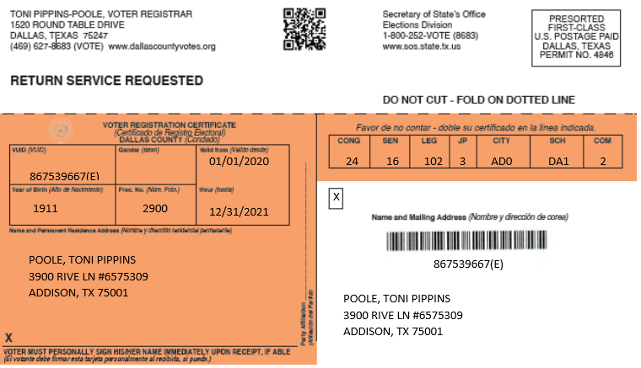
Social Action Committee Announcements September 2023
Voter Registration – Fall Pecan Street Festival 9/16/23 - 9/17/23; pecanstreetfestival.org
National Voters Registration Day – September 19th
PSA video promoting National Voter Registration Day
Voter registration drives at local community high schools
Social Justice Weekend September 22 – 24
VOTER ACTION INVITATION - OMEGA VOTER ACTION PROJECT, September 16th at Huston - Tillotson University in the Campus Student Union from 9:00 a.m. until 3 p.m.

Slide 48
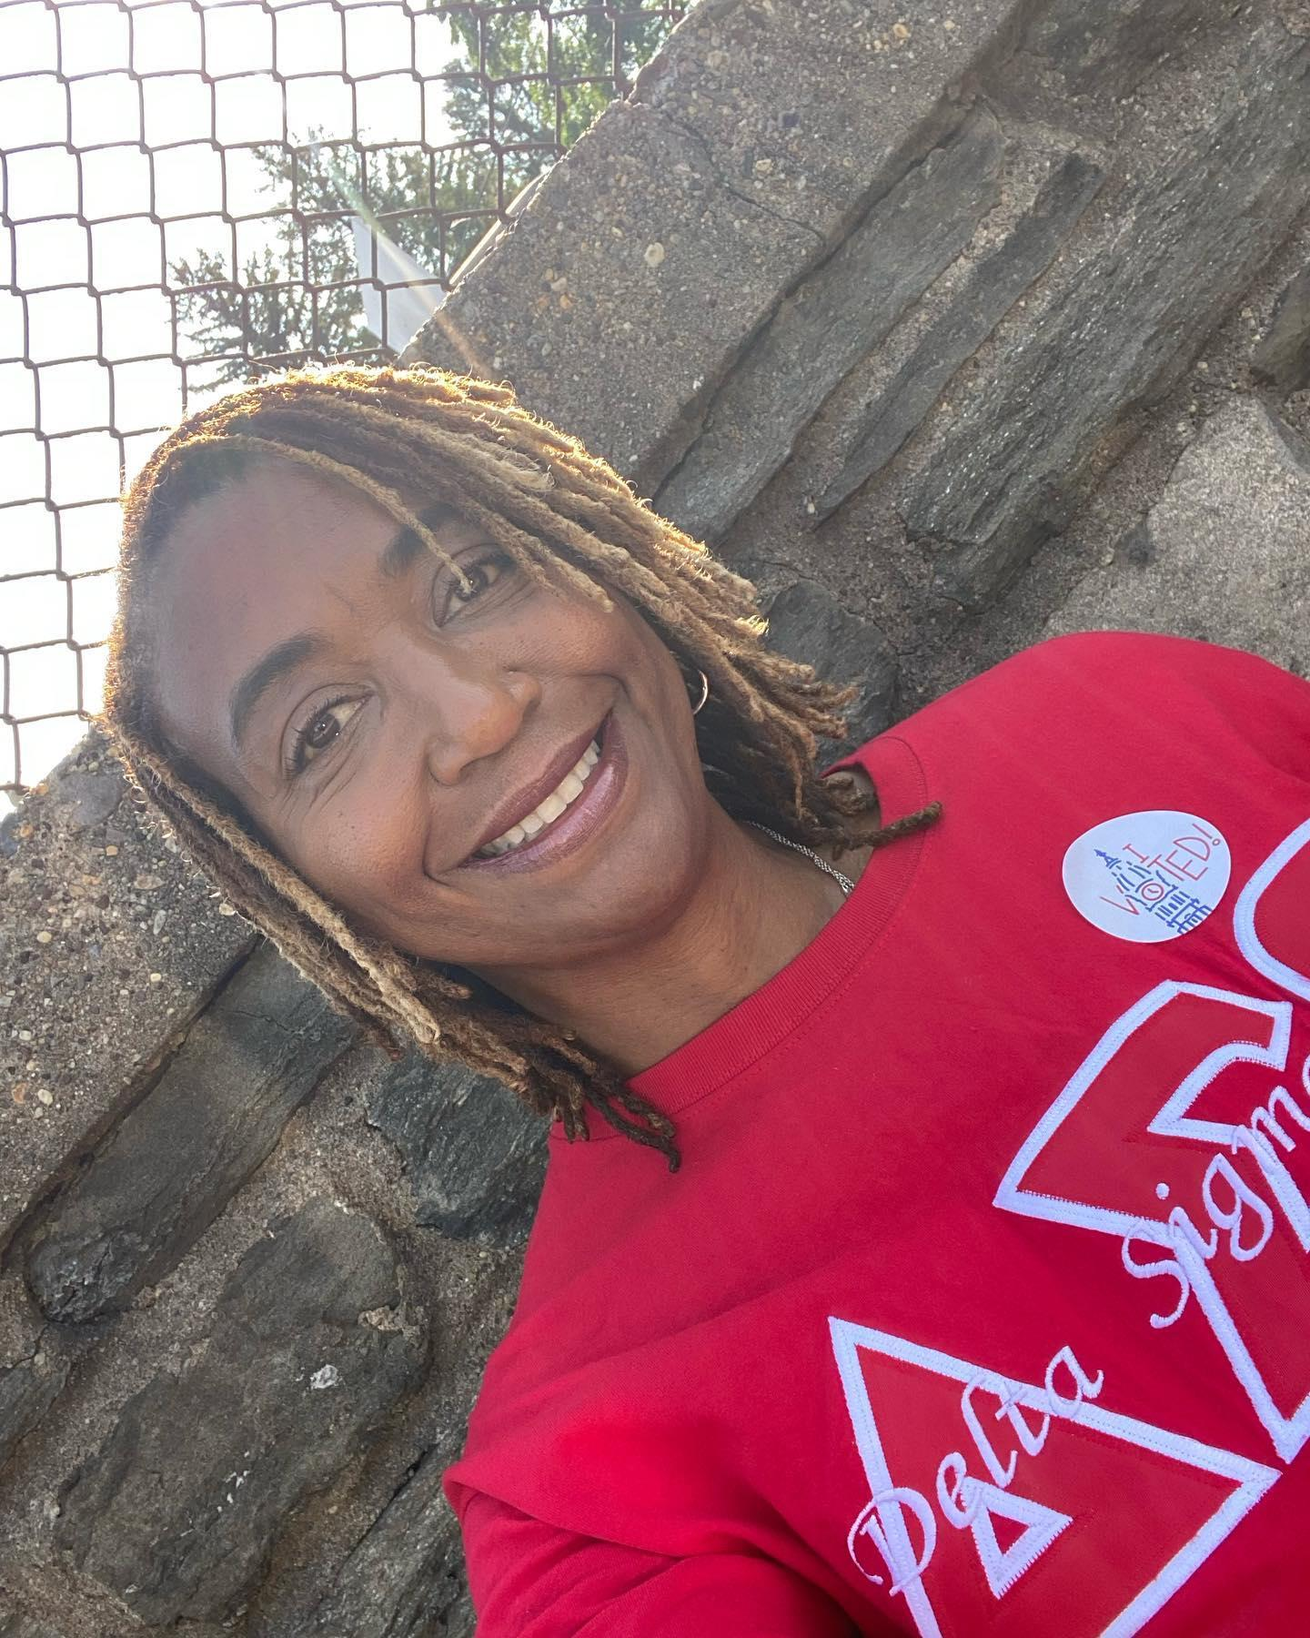
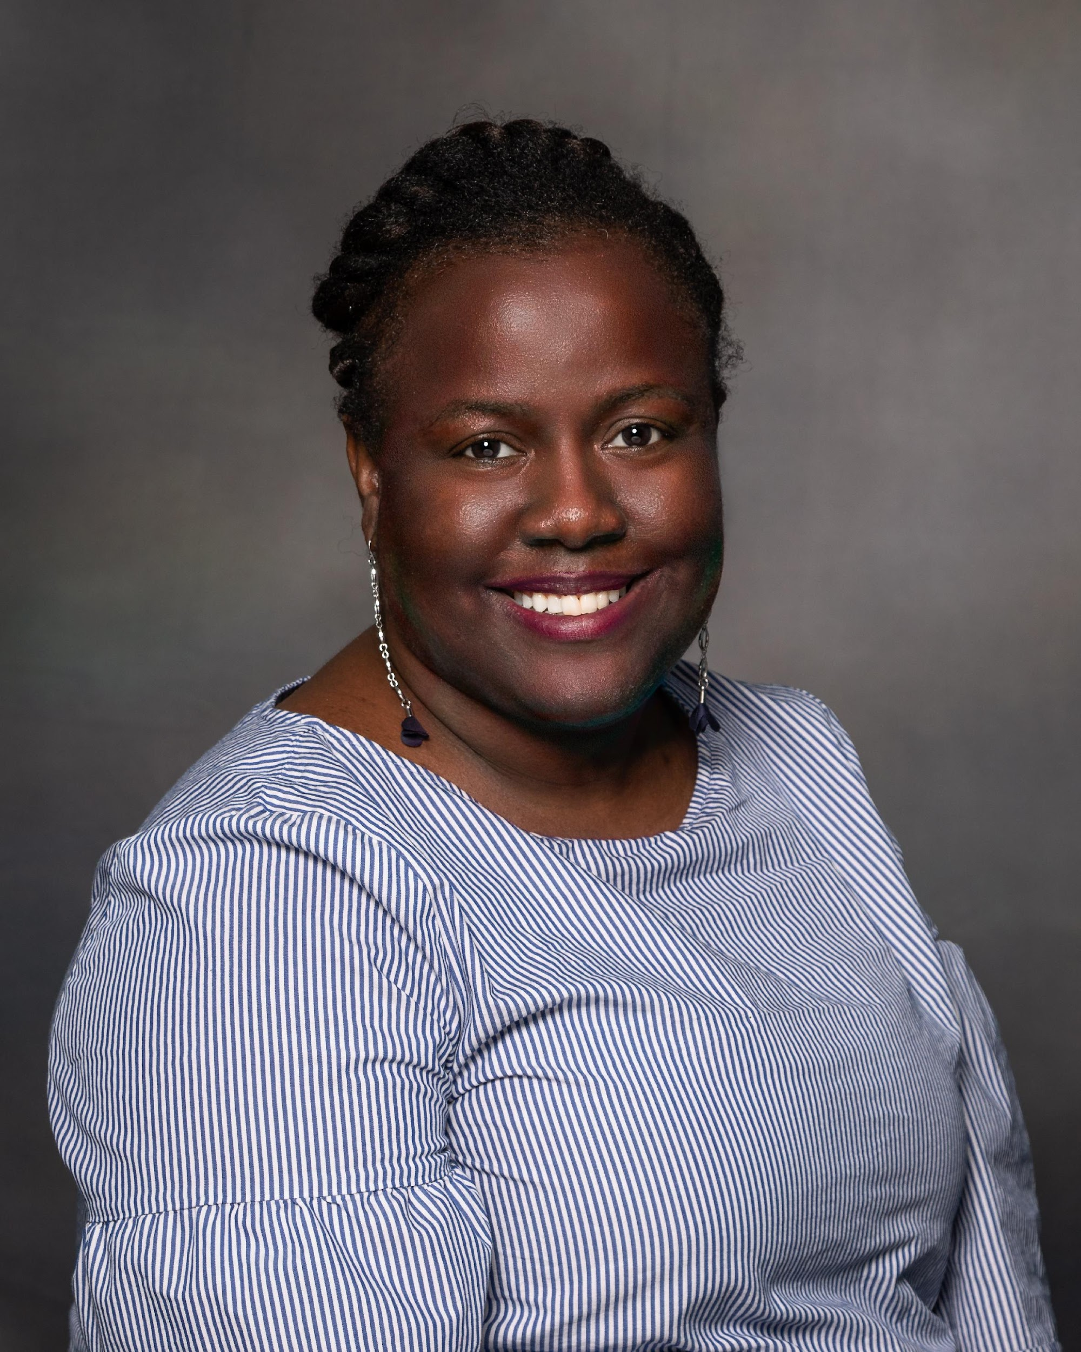
Social Action Committee Members 2023 – 2024 Meeting 2nd Tuesday of each month - 6:30 pm - 8:00 pm cst. Via zoom
April Briscoe
Jeri Brooks
Syerra Cunningham
Gloria Frazier
Jacqueline Habersham **
Kacey Hanson **
Vanessa Henry
Patricia Hicks
Delphea Jester
Ashley Johnson
Renee Jones
Erica Knox
Darlene Lewis
Latisha McGee
Freda Mills
Lisa Newman
Marva Overton
Regina Patridge
Veronica Pickett Johnson *
Joan Roberts Scott
Krishella Robinson
Dewi Smith
Melody Southall
Adrienne Thrasher
Paulette Walls
Belinda Williams
Celeste T. Williams *
Quorum requirements: 7 members (25%)
*Denotes Committee Co-chairs
** Denotes Chapter Vice Presidents

Slide 49
Executive Board Recommendation
Moves that the school board meetings for Pflugerville, Hutto, Round Rock, Manor and Austin be added to the chapter’s program calendar.

Slide 50
Meeting Agenda
Committee Reports
Five Point Thrust
Arts and Letters
Social Action
Social Action Moment
Standing Committees
Unfinished Business
New Business
Announcements
Adjournment

Slide 51
Social Action Moment
Co-Chairs: Sorors Veronica Johnson & Celeste Williams

Slide 52
Slide Title
Voting and Civic Engagement
Education
Health Equity
Re-Imagining Public Safety
Reproductive Justice
Economic Justice
Environmental Justice

Slide 53
Voting and Civic Engagement
ADVOCACY FOCUS
ACTIONS TO TAKE
Oppose efforts to limit access to voting such as Voter ID laws, limitations on voting eligibility, reductions in polling hours or days, restrictive requirements for absentee voting, Efforts to allow interference with the work of local Boards of Elections absence evidence of specific issues or malfeasance, and interference in the ability to assist or transport voters.
Engage with your Secretary of State and/or local Board of Elections to ensure equitable distribution of polling places and prevent intentional overcrowding of polls.
Advocate for expanded voting access including early voting, no excuse absentee voting, expanding polling hours, same day registration, online voter registration in your state.
Talk to registered voters who are not voting to help develop a community strategy to increase the number of registered voters who vote in elections, particularly in the non-presidential years.
Consider adopting a polling location.
Incorporate voter registration and education at all public events.
Learn how to track bills filed in your state legislature. Sign up for email alerts for bills related to the census, redistricting and voting. Create a Social Action subcommittee that will monitor bills and provide updates on their status to the chapter.

Slide 54
Education
ACTIONS TO TAKE
ADVOCACY FOCUS
Advocate for investments in school infrastructure and resource equity
Ensure your chapter members and community members vote in School Board or Board of Education elections.
Educate the community about efforts to remove Black history from school curriculums.
Engage with school boards, Departments of Education and legislatures, as appropriate, to monitor any attempts to alter the curriculum by removing Black history.
Address the erasure of Black history from school curriculums and the unfounded attacks on Critical Race Theory.

Slide 55
Meeting Agenda
Committee Reports
Standing Committee
Internal Audit
Ways and Means
Executive Committee
Unfinished Business
New Business
Community Partnership
Physical and Mental Health Moment
Adjournment

Slide 56
Internal Audit
Chair: Soror Sophia Williams

Slide 57
4th Quarter - Internal Audit April 1, 2023 – June 30, 2023
Validations:
∆ 50% - Receipts (67)
∆ 10% - Non-check disbursed (9)
∆ 25% - Checks disbursed (22)
∆ 100% - Membership dues (48)
Total Disbursements (expenses) = $27,040.93
Gross Receipts (revenue) = $128,747.31
Financial Members = 311

Slide 58
4th Qtr Summary Findings
√ Good fiscal controls in place.
√ Reports correctly represent the financial status.
√ Accounts were reconciled.
√ Balances are accurate as of June 30, 2023.

Slide 59
OVERALL FINDINGS
Austin Alumnae chapter has satisfactory financial internal controls, and the review supports the existence and utilization of these controls.

Slide 60
Meeting Agenda
Committee Reports
Standing Committee
Internal Audit
Ways and Means
Executive Committee
Unfinished Business
New Business
Community Partnership
Physical and Mental Health Moment
Adjournment

Slide 61
Ways and Means
Chair: Soror Alnita Foote

Slide 62
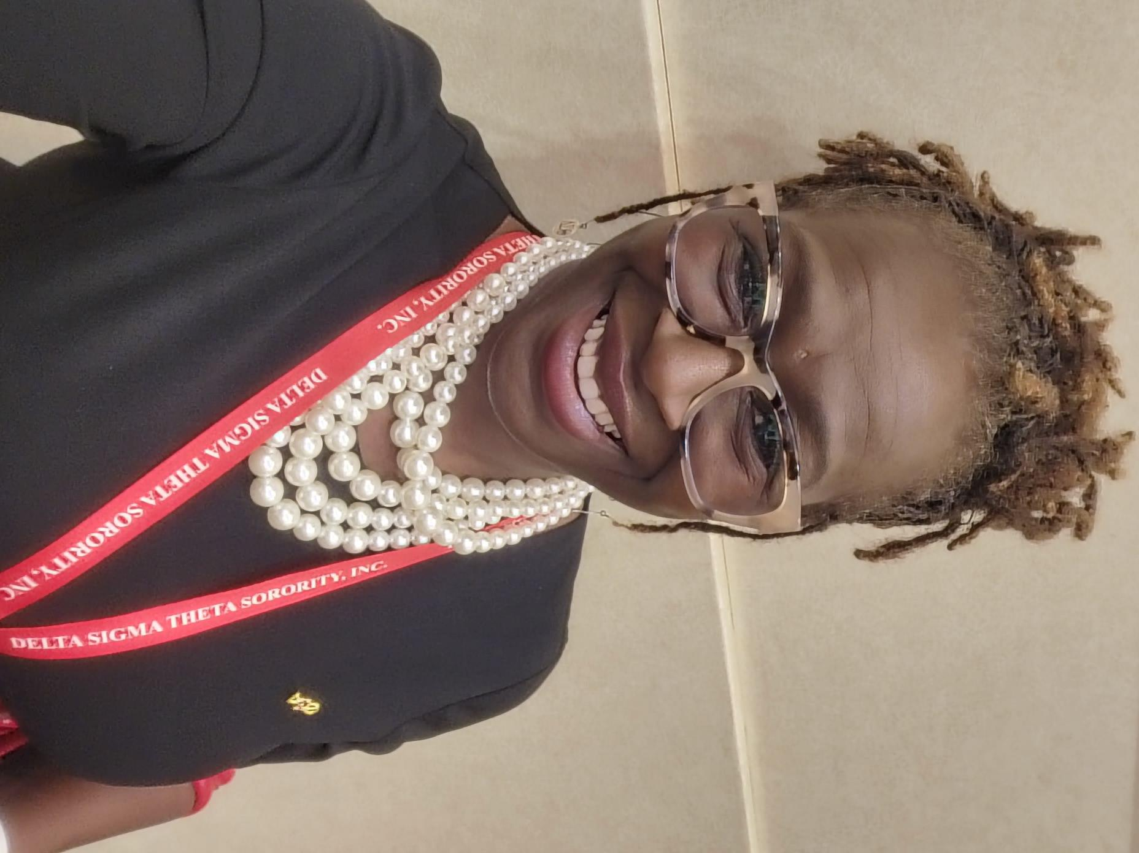
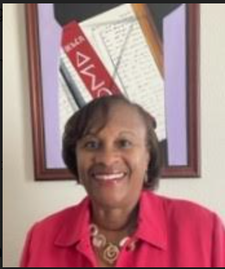
Ways & Means and Austin Delta Foundation
Goal is to raise over $30K
Alnita Foote
Gwen Bingham
dstatx.wm@gmail.com

Slide 63
Ways & Means and Austin Delta Foundation
Austin Delta Foundation
Austin Alumnae Chapter
Pamela Sherman
Vanessa Henry
Sekoya Waddy
Pam Hall
Joan Roberts-Scott
Robin Blackmon
Alnita Foote
Gwen Bingham
We Need You!!

Slide 64
Meeting Agenda
Committee Reports
Standing Committee
Internal Audit
Ways and Means
Executive Committee
Unfinished Business
New Business
Adjournment

Slide 65
Executive Board Recommendation
Move that we hold executive board meetings on the Tuesday before
chapter meeting on Zoom at 7:00 p.m. beginning this sorority year.

Slide 66
Meeting Agenda
Committee Reports
Standing Committee
Internal Audit
Ways and Means
Executive Committee
Unfinished Business
New Business
Announcements
Adjournment

Slide 67
Meeting Agenda
Committee Reports
Standing Committee
Internal Audit
Ways and Means
Executive Committee
Unfinished Business
New Business
Announcements
Adjournment

Slide 68
Budget & Finance Recommendation
Move that we decrease the ADF Contribution line item ($3900) by $1000 to fulfill the request from the AKA Sorority and future D9 requests after that fact.

Slide 69
Budget & Finance Recommendation (Amended)
Move that we decrease the ADF Contribution line item ($3900) by $1000 to fulfill the request from the AKA Sorority ($245) and future D9 requests after that fact.

Slide 70
Announcements

Slide 71
Announcements
Executive Board Meeting
Tuesday, October 3, 2023 - Virtual
https://zoom.us/meeting/register/tJAuceuprDgsE92JfgXwdl7vmjQBNVhfPmUb
Chapter Meeting
Saturday, October 7, 2023 - In Person
ACC Highland Campus
Chapter Document Passwords
Chapter Roster | <AAC>R0S7ER!
Treasurer’s Report | d5t^R3P097
Sister II Sister Circle | DSTatx^1913

Slide 72
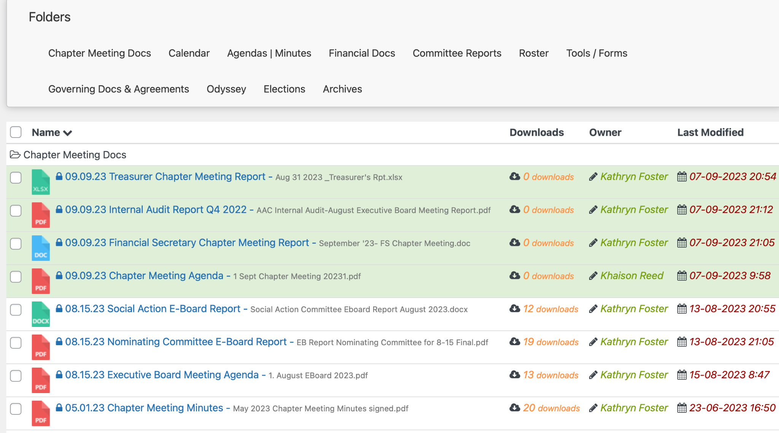
Announcements
Chapter Meeting Documents
Documents Library → Chapter Meeting Docs (folder)

Slide 73
Announcements
Our next Budget and Finance Committee meeting will be October 11, 2023. Committee chairs should submit ALL budget adjustment requests for both the SY2023 and FY2024 no later than September 15, 2023.
Committee chairs - Please remember to include your up-to-date committee ledger with your voucher requests. We have been very lenient so far – but will be returning any future requests that do not include your committee ledger. This is to ensure that you have sufficient funds for the voucher request you are submitting.

Slide 74
Meeting Agenda
Committee Reports
Standing Committee
Internal Audit
Nominating Committee
Unfinished Business
New Business
Community Partnership
Announcements
Adjournment
“Theme Song” Video after closing

Slide 75
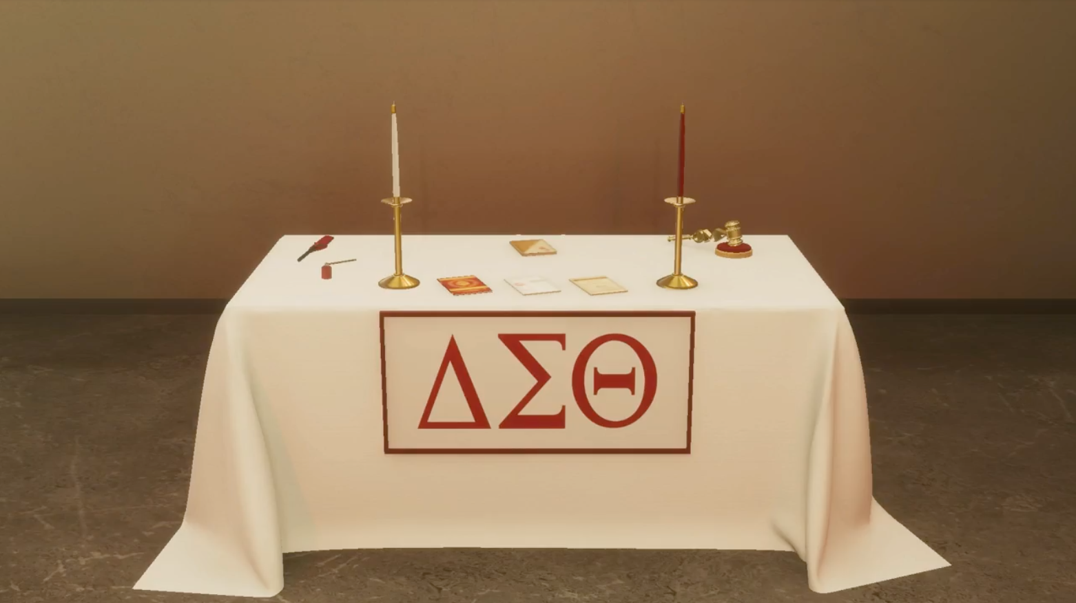

Slide 76
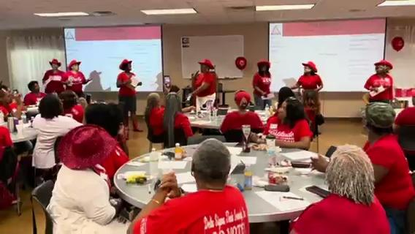
2023 Theme Song

